Slide 1
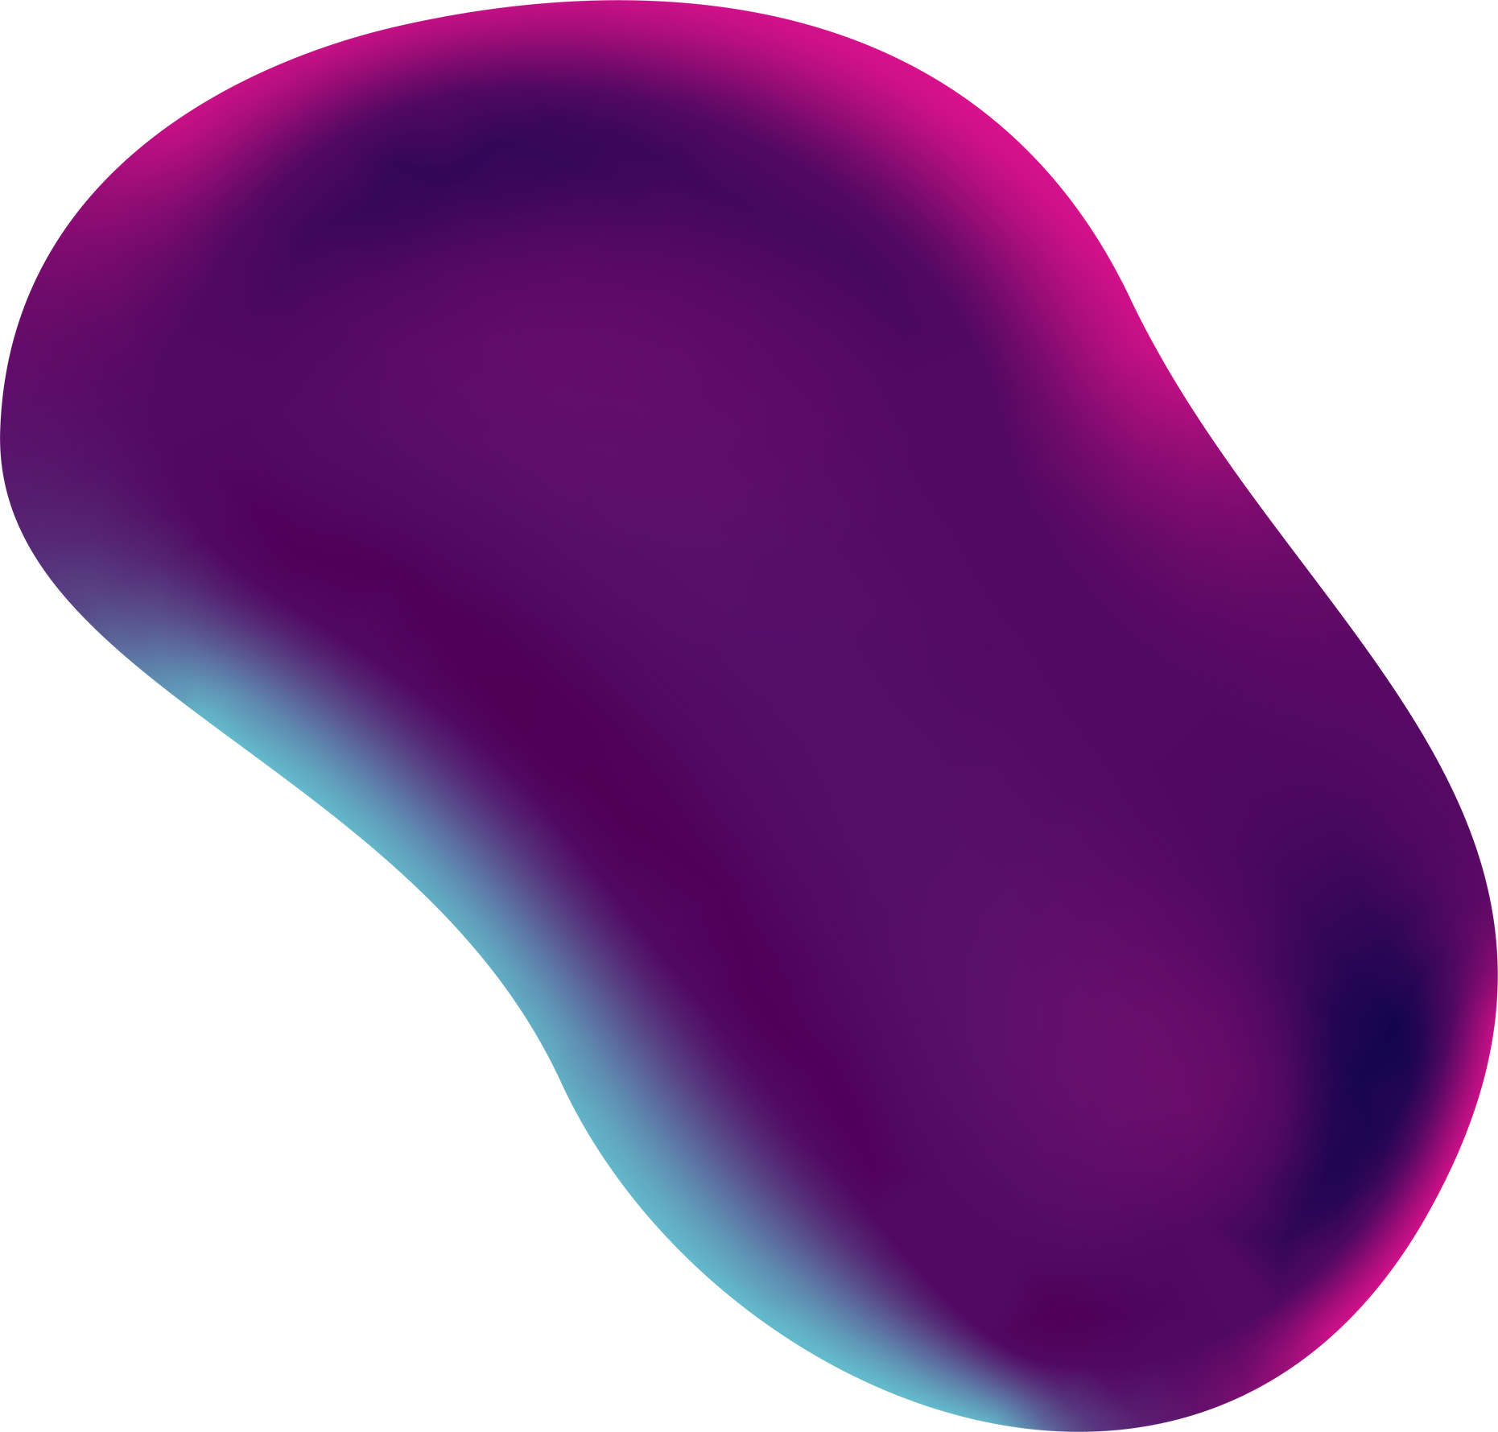

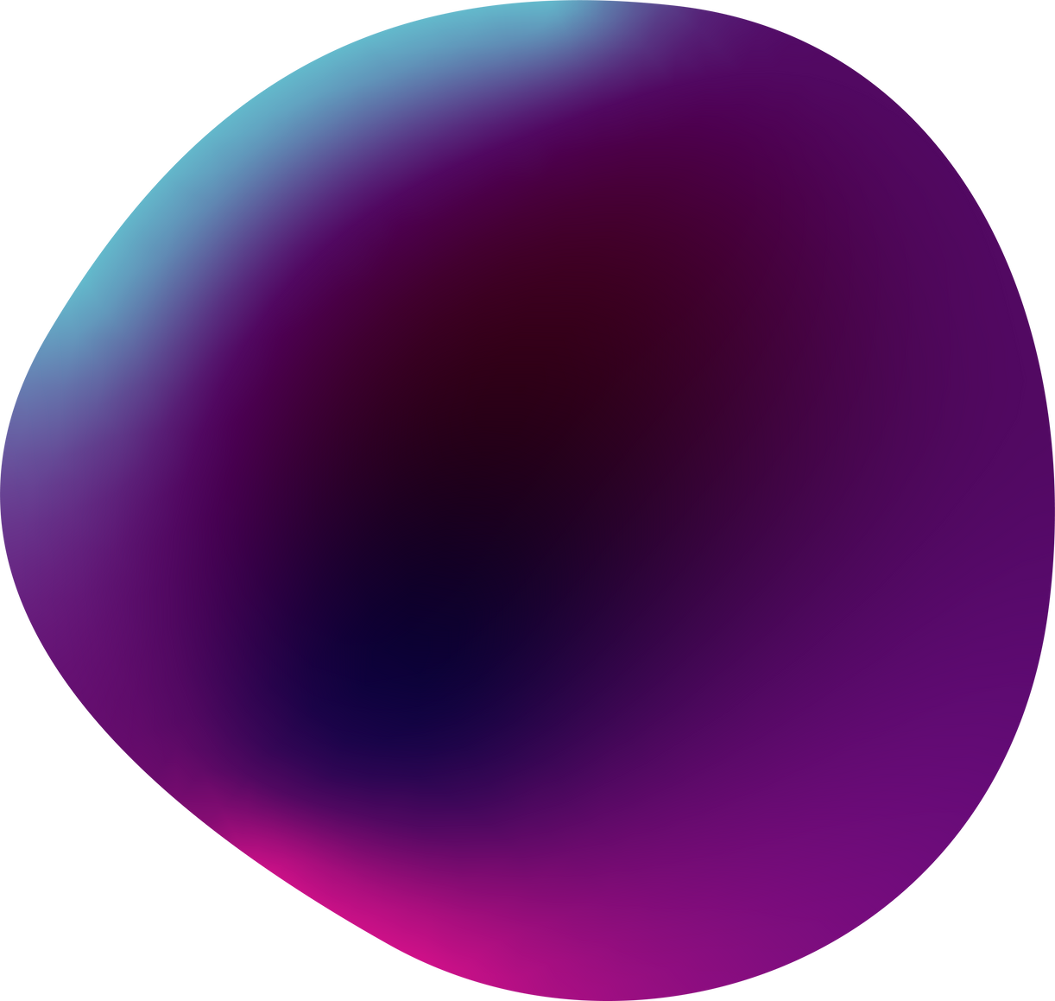
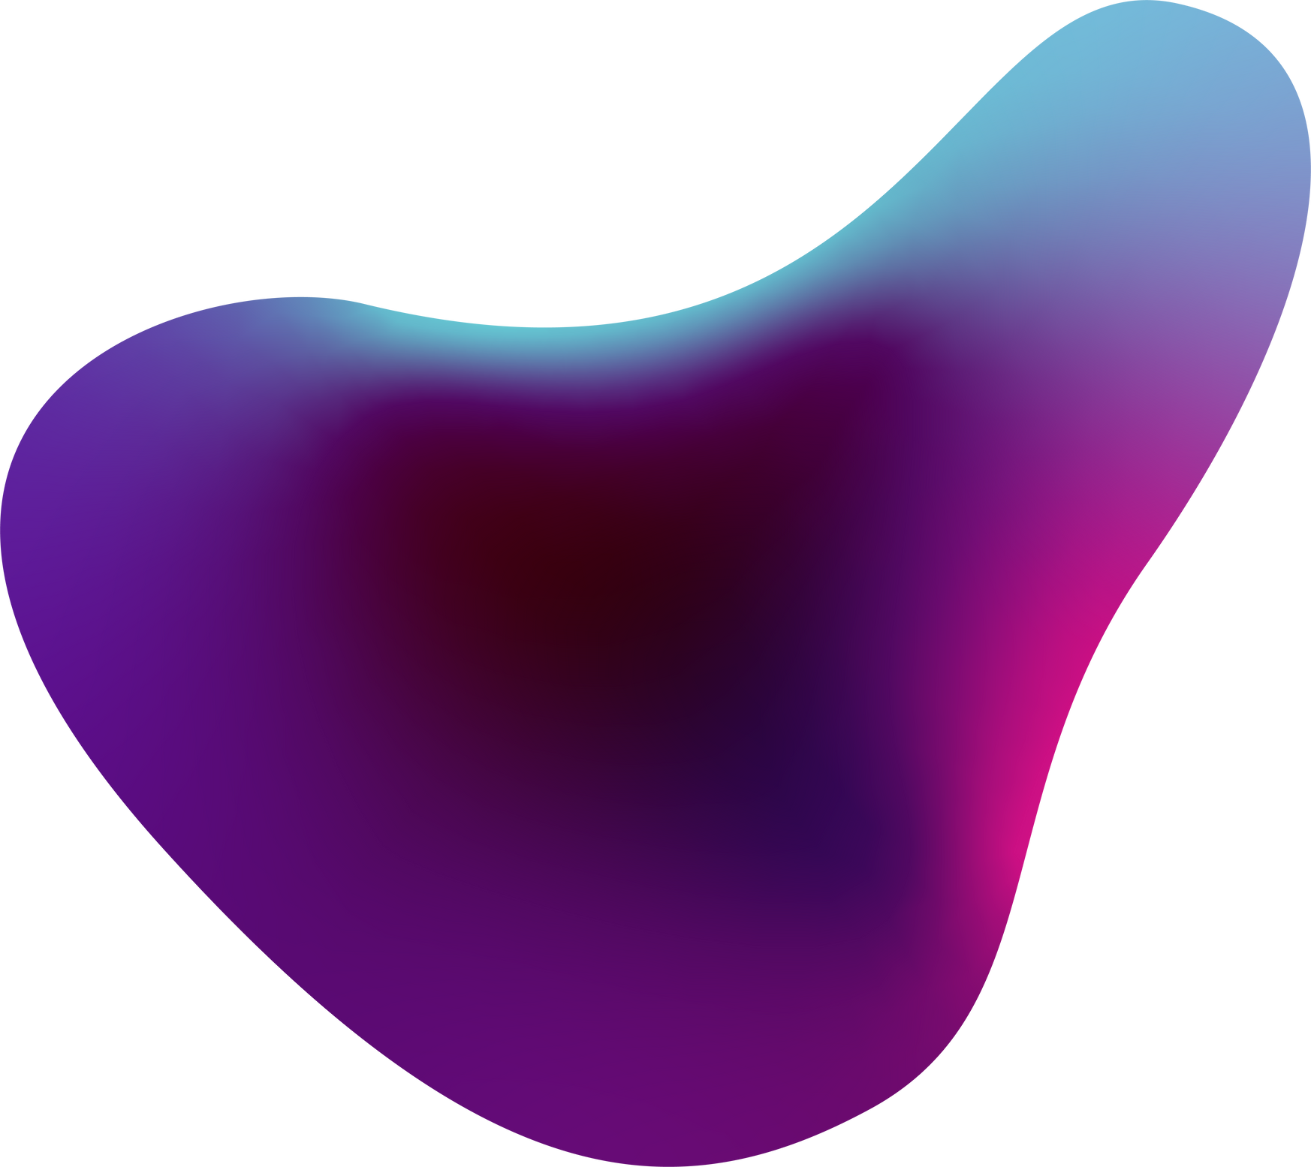
01
DISASTER MANAGEMENT APPLICATION
“HEROE”
Presented by: GROUP 2

Slide 2

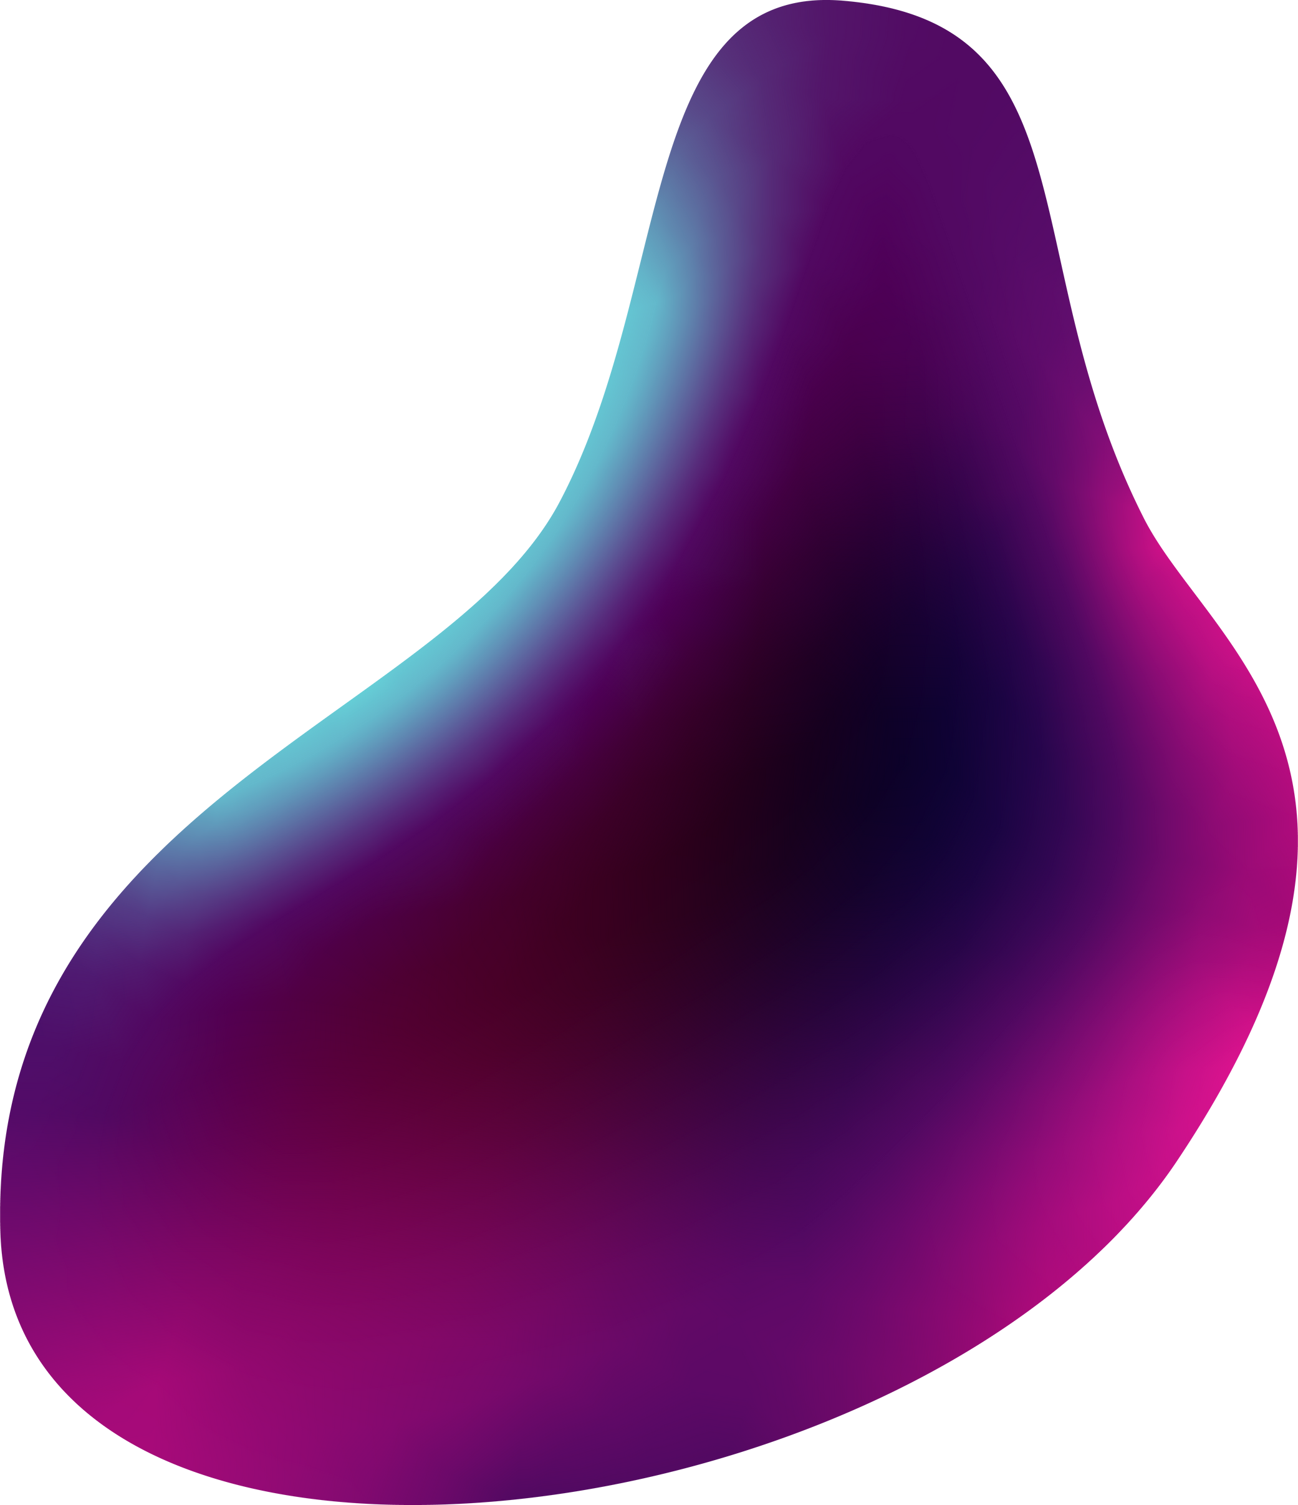
02
Presentation Outline
1) INTRODUCTION
2) REQUIREMENT GATHERING
3) REQUIREMENT ANALYSIS
4) SYSTEM MODELLING
5) UI DESIGNING
6) IMPLEMENTATION
7) CONCLUSION

Slide 3
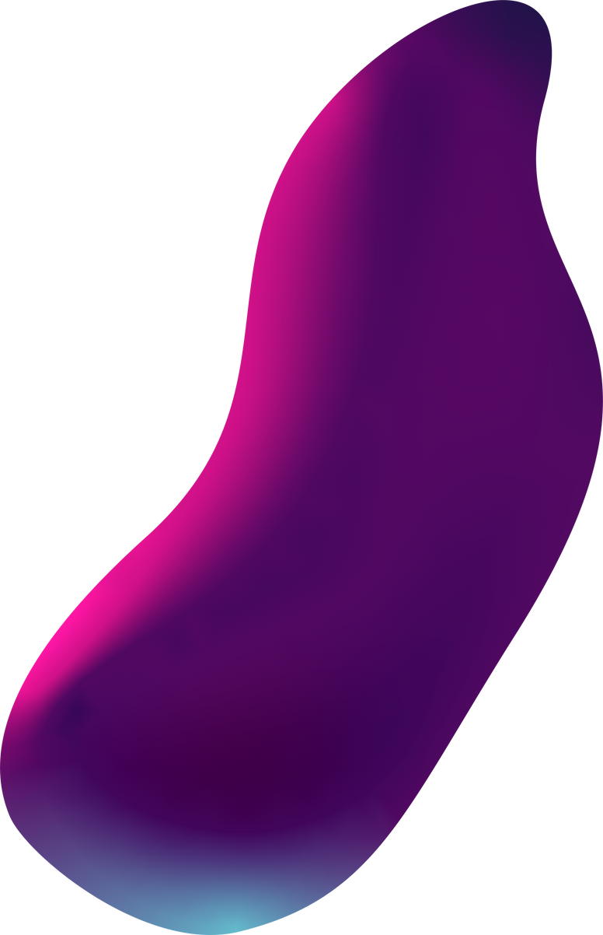
03
INTRODUCTION
A disaster management mobile application is a tool designed to help individuals and communities prepare for, respond to, and recover from natural or man-made disasters. These applications typically provide information on emergency preparedness, reschedule time alerts and updates during a disaster, resources for immediate assistance, and guidance on how to navigate the aftermath of a disaster.
The design of a disaster management mobile application prioritize ease of use, accessibility, and reliability. The user interface should be intuitive and user-friendly, with clear navigation and easily accessible information. The application should also be designed to work in low-connectivity or offline environments, as network infrastructure may be compromised during a disaster.

Slide 4
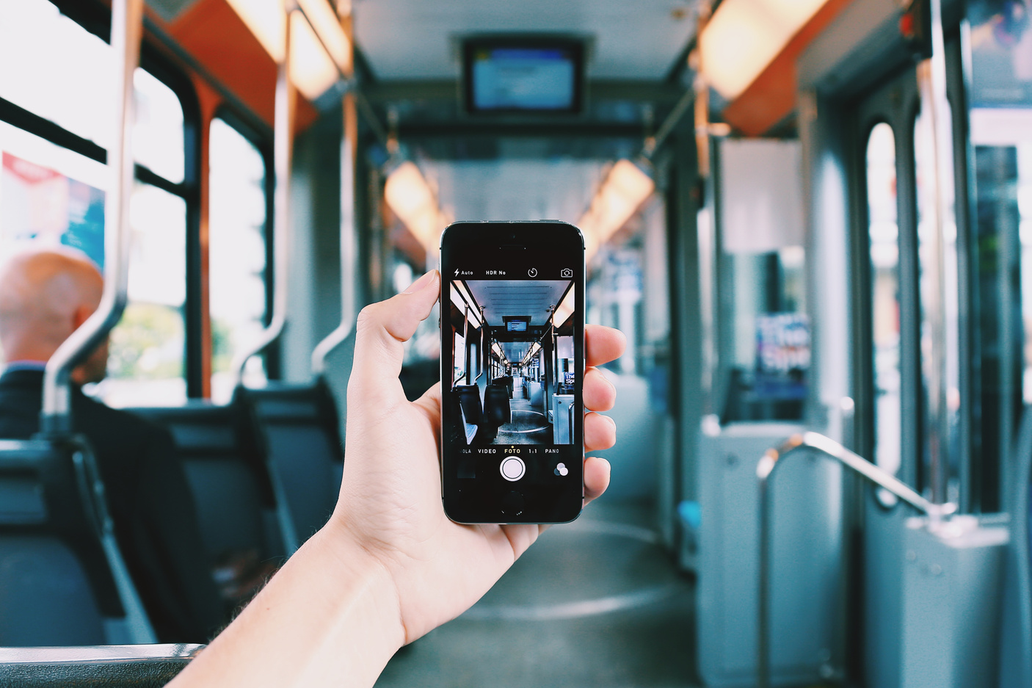
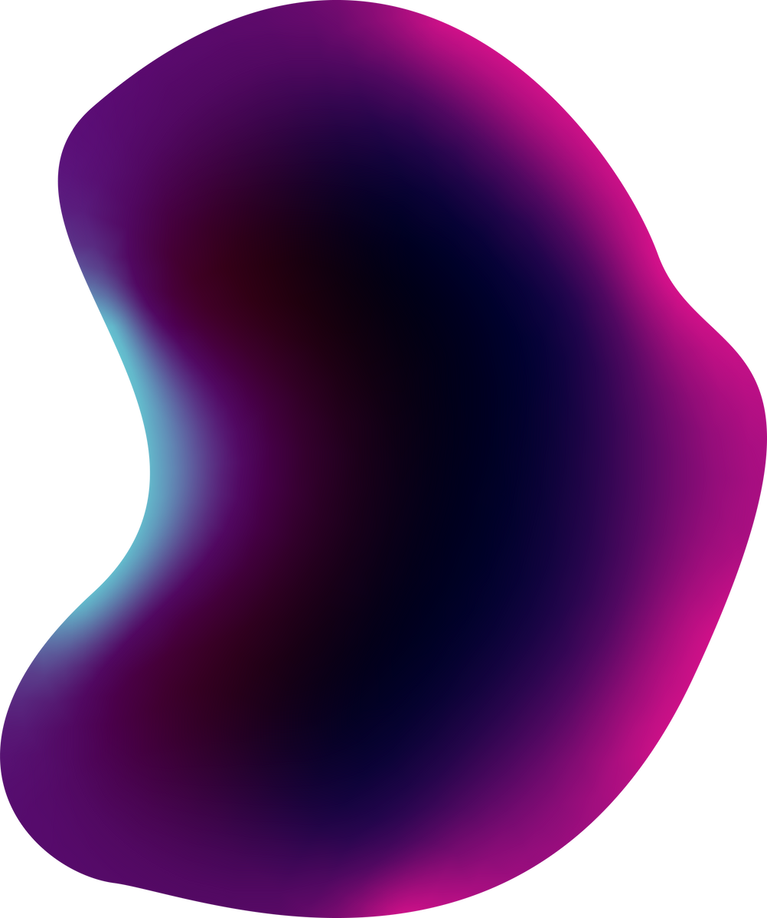
04
REQUIREMENT GATHERING
In today's world, natural disasters and emergencies are a constant threat. To effectively manage these situations, we need robust disaster management systems. Traditional methods, often reliant on manual processes and scattered communication channels, struggle to deliver timely and coordinated responses. This project proposes a solution: a Mobile-Based Disaster Management System. Research, focus group, survey forms, interviews were used to gather these requirements.

Slide 5


05
REQUIREMENT ANALYSIS
FUNCTIONAL REQUIREMENTS
1) Real-time Alerts and Notifications
2) Incident Reporting and Assistance
3) Geospatial Data and Mapping Services
4) Emergency Contacts and Services
NON-FUNCTIONAL REQUIREMENTS
1) Privacy and Security
2) Usability
3) Reliability
4) Accessibility

Slide 6
06
SYSTEM MODELLING
In order to effectively manage disasters, it is essential to have a comprehensive plan in place that includes the use of mobile technology. The Unified Modeling Language (UML) is a standard modeling language that can be used to design and design software systems. UML provides a set of graphical notations that can be used to represent the different aspects of a software system, including its architecture, behavior, and data.

Slide 7
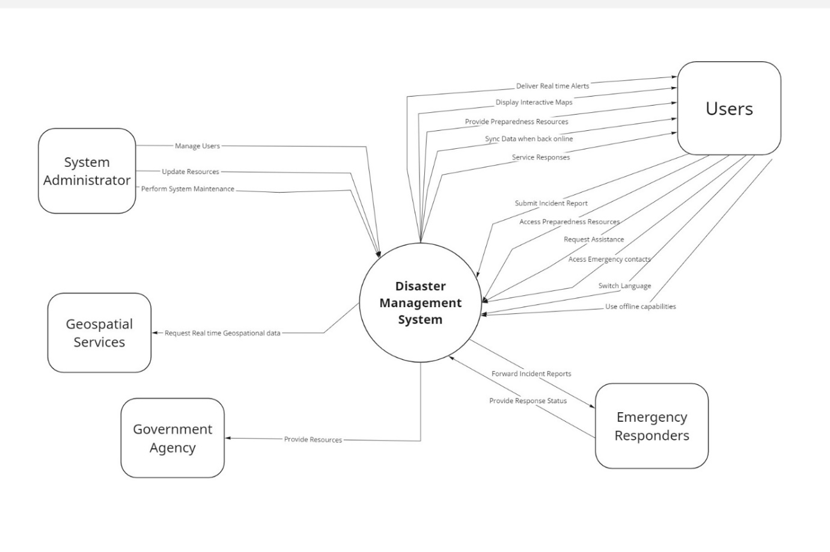
CONTEXT DIAGRAM

Slide 8
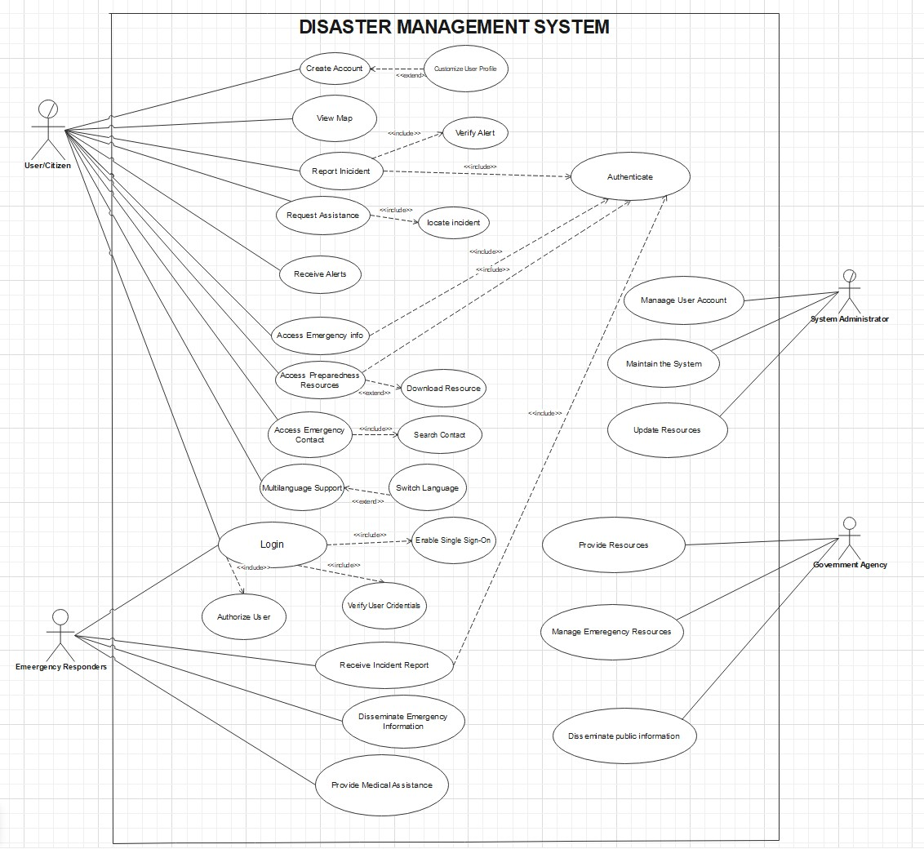
USECASE DIAGRAM

Slide 9
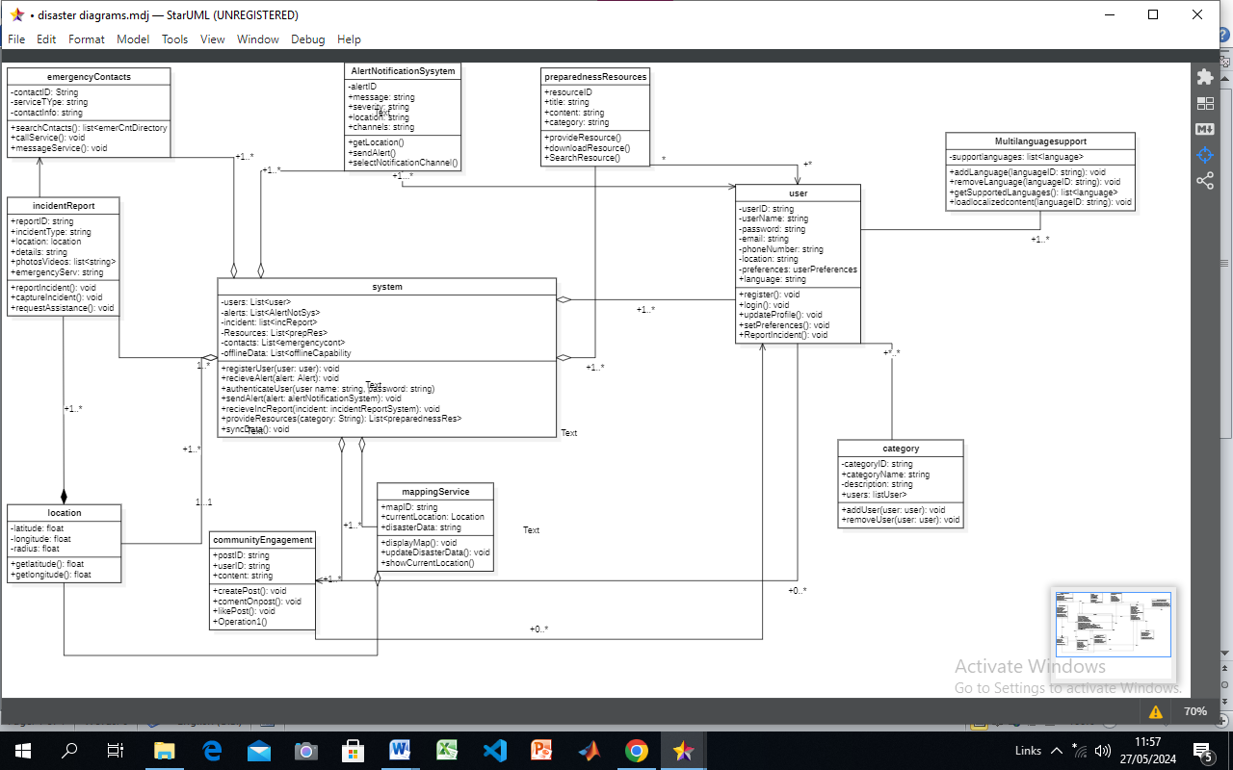
CLASS DIAGRAM

Slide 10
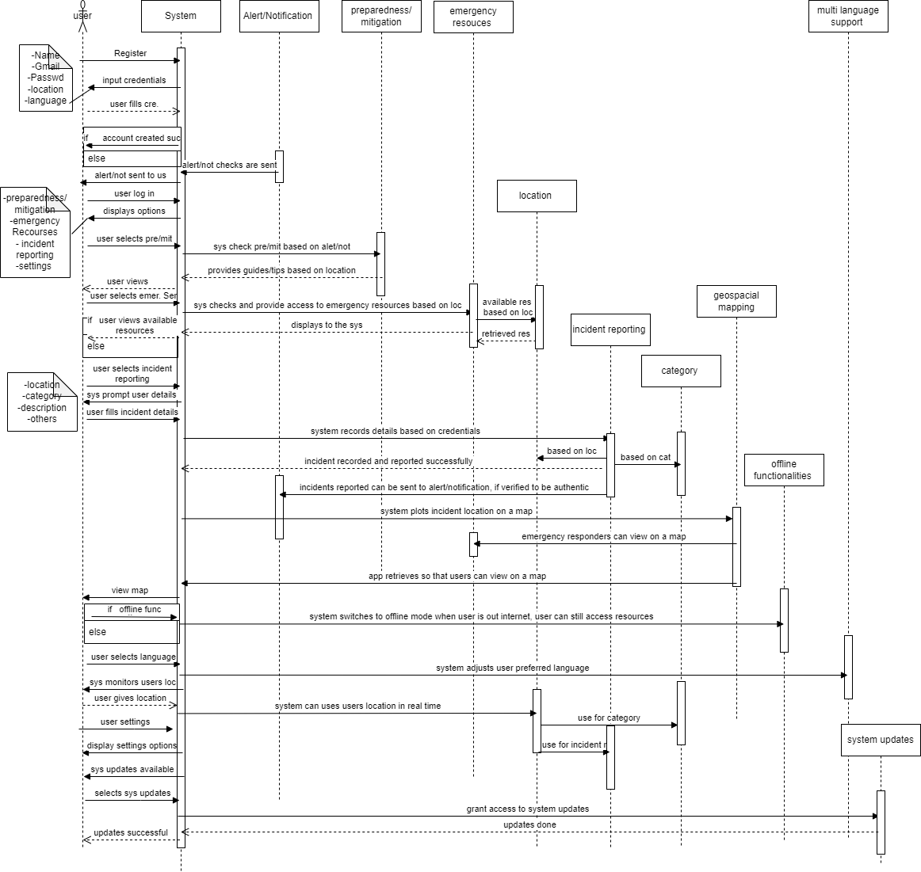
SEQUENCE DIAGRAM

Slide 11
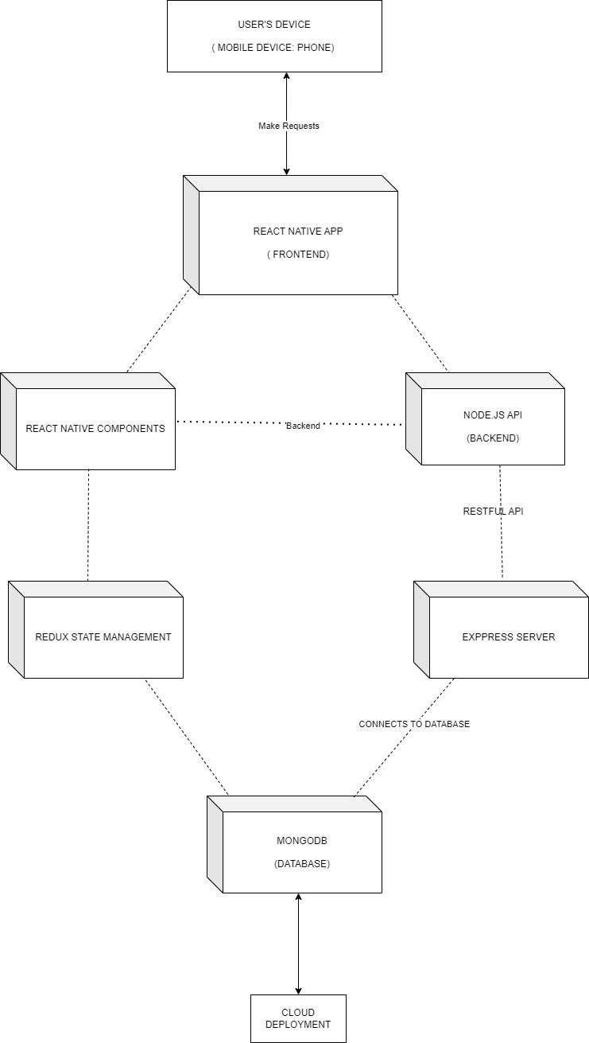
DEPLOYMENT DIAGRAM

Slide 12
08
UI DESIGN
This design phase outlines the process of creating a disaster management mobile application aimed at providing timely assistance and resources to individuals affected by disasters. Through personas, user journey maps, wireframing, and implementation using Figma, the application seeks to address the diverse needs of users during crisis situations, fostering resilience and community support.

Slide 13
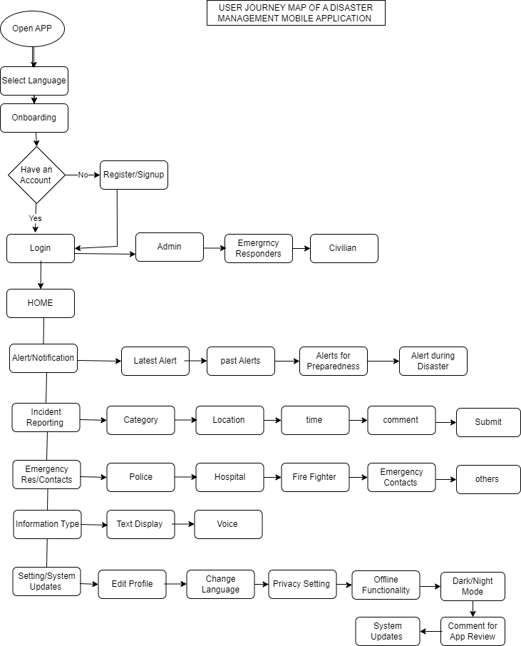
USER JOURNEY MAP

Slide 14
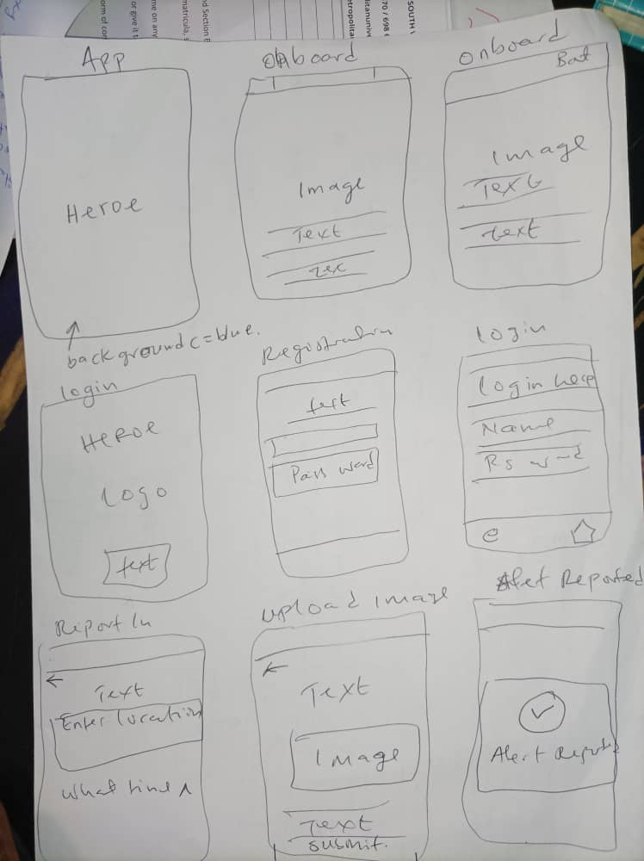
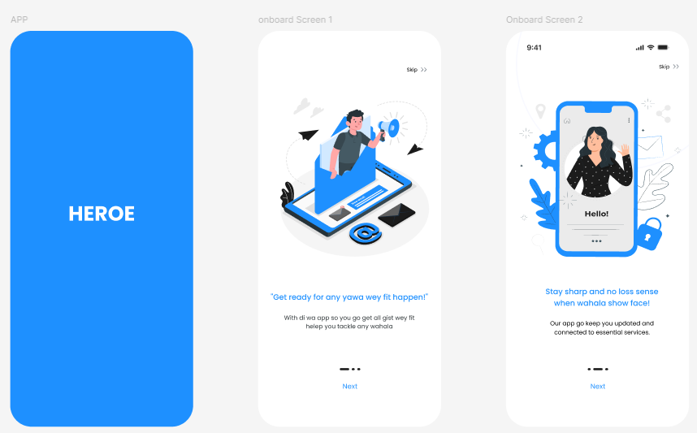

Slide 15
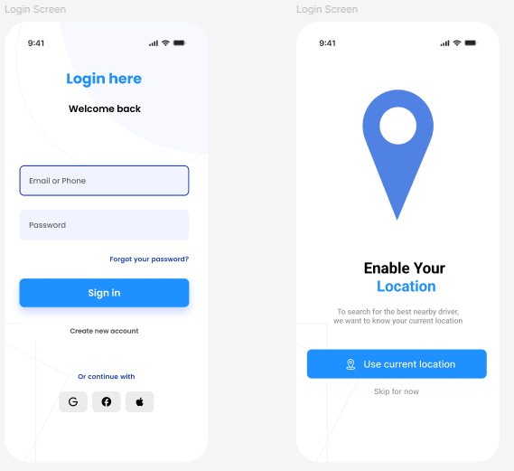
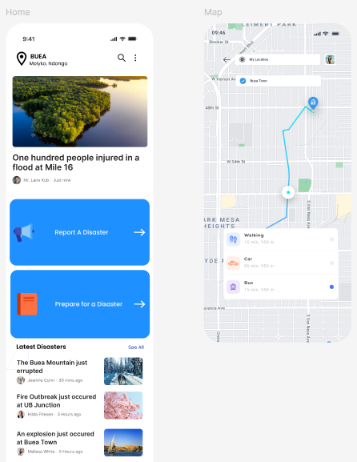

Slide 16
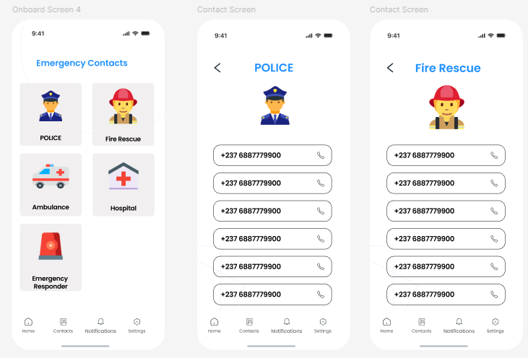
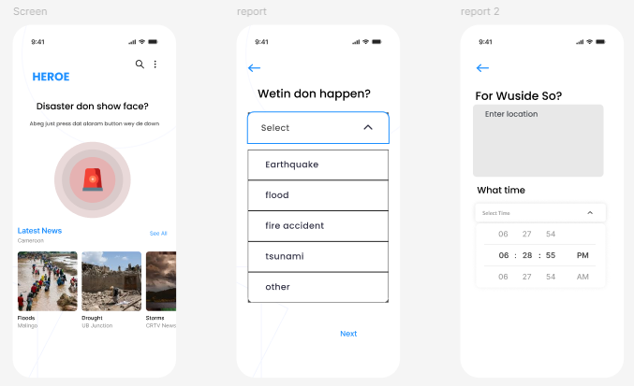

Slide 17
The implementation of a disaster management mobile application (DMA) developed using React Native and Firebase. The application aims to empower users with the tools and information necessary for preparedness, communication, and response during emergencies.
IMPLEMENTATION

Slide 18
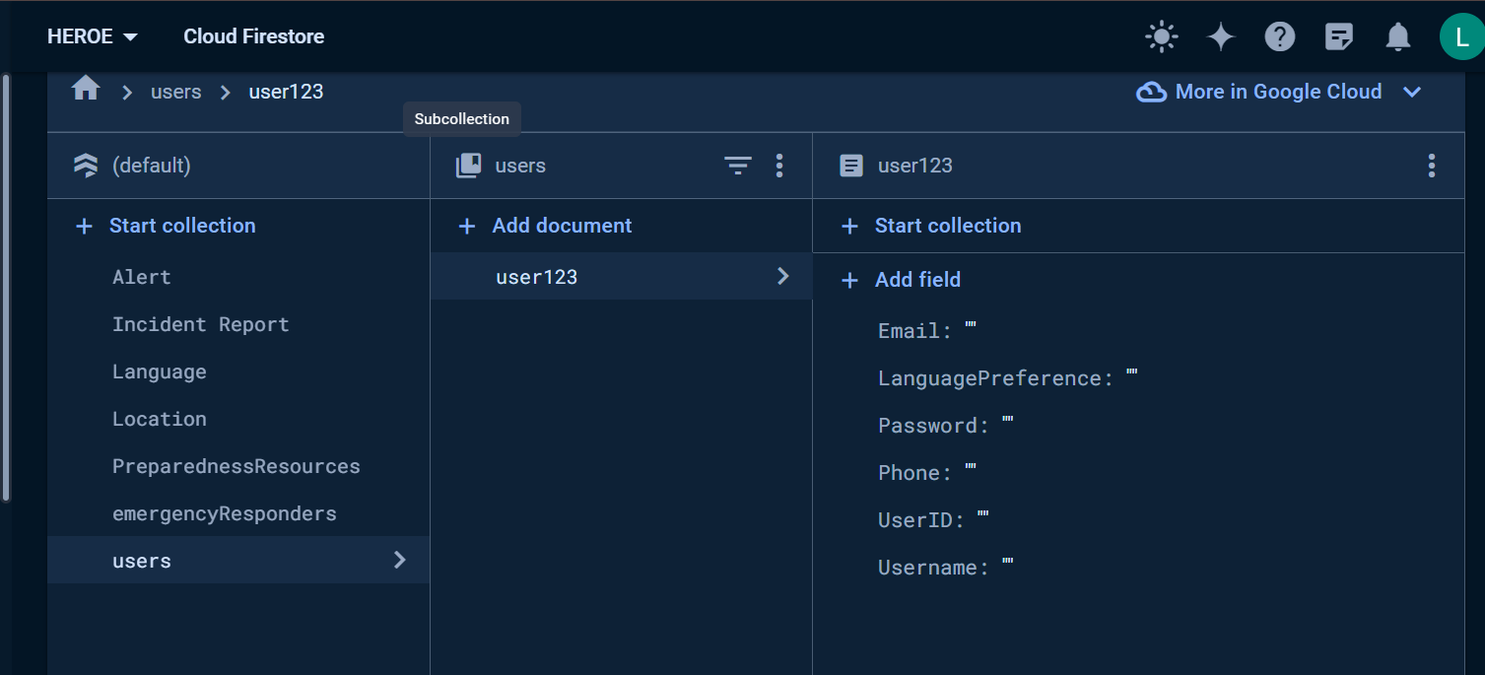

Slide 19
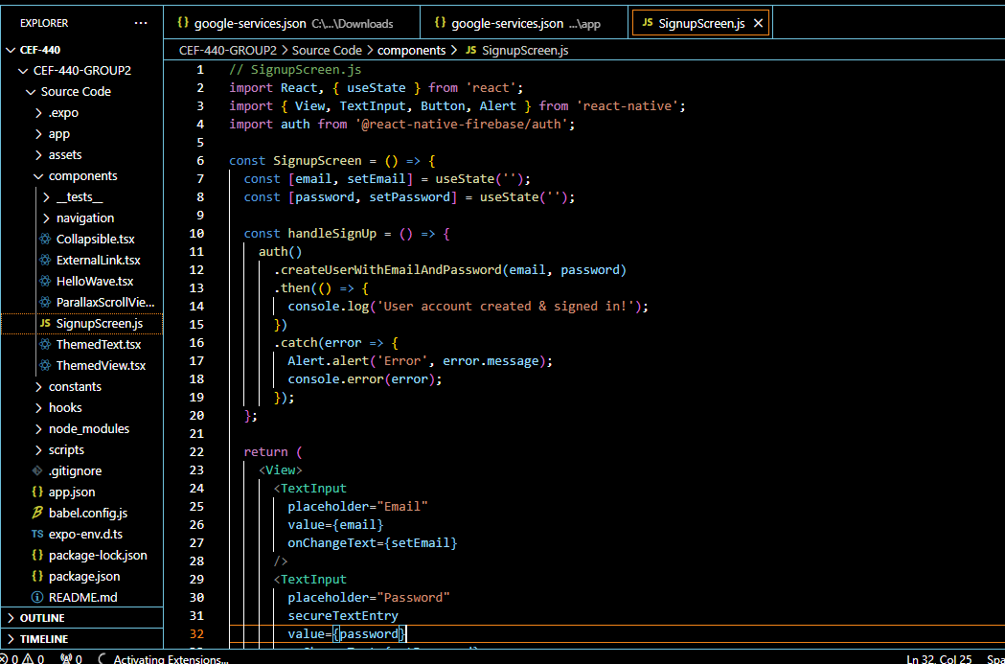

Slide 20
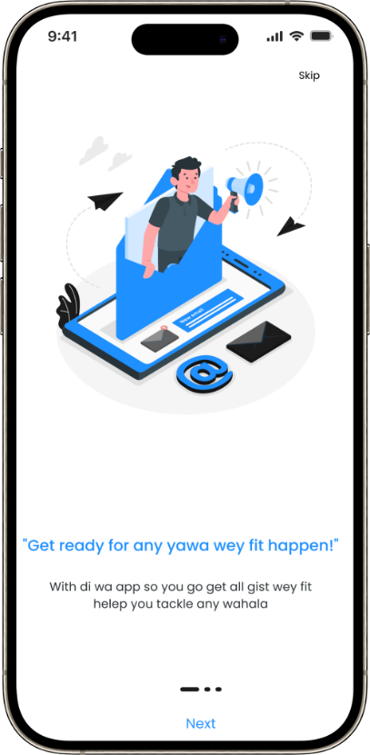
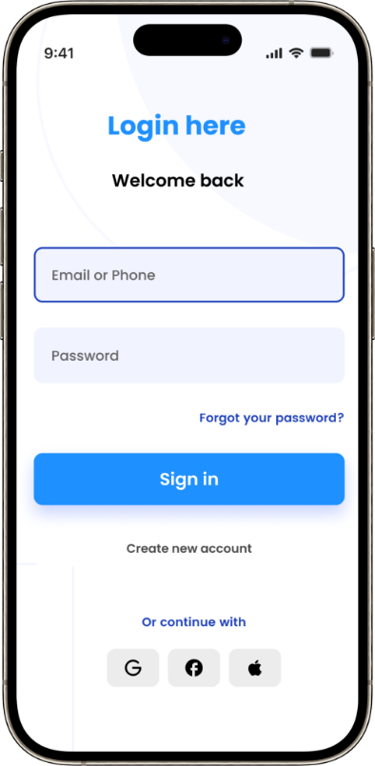
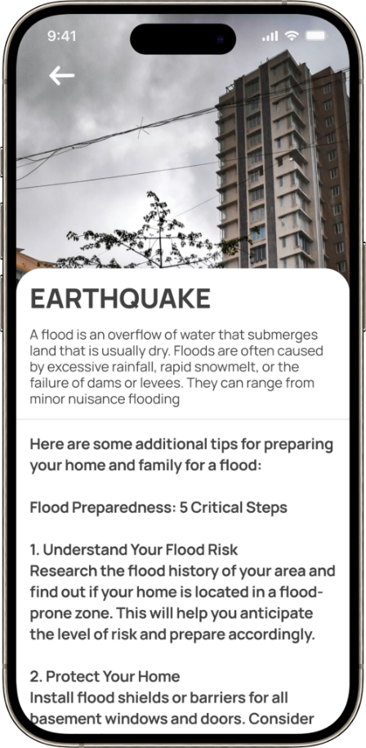
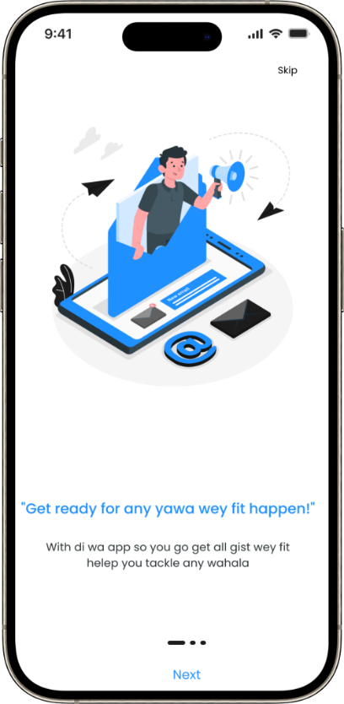
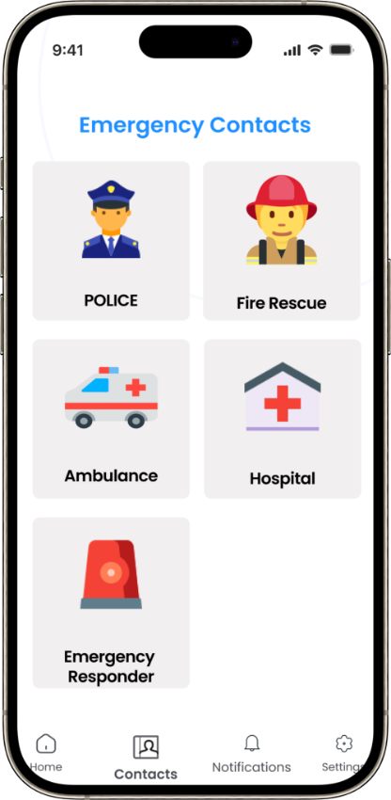
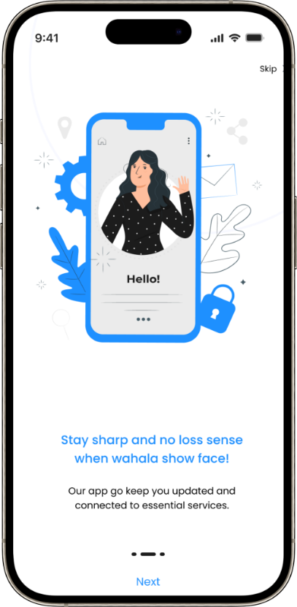
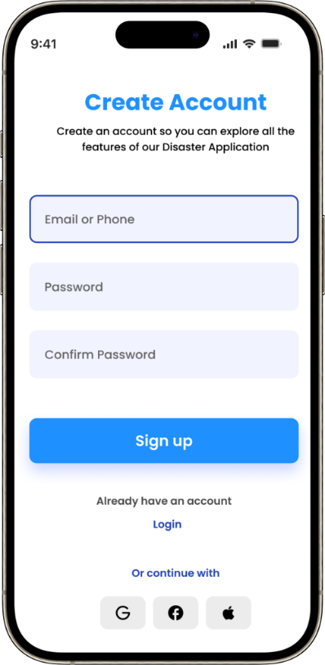
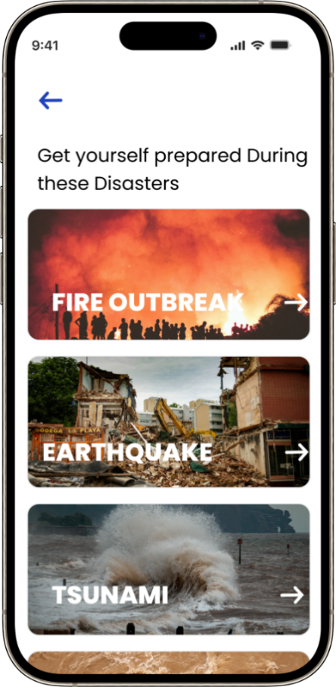
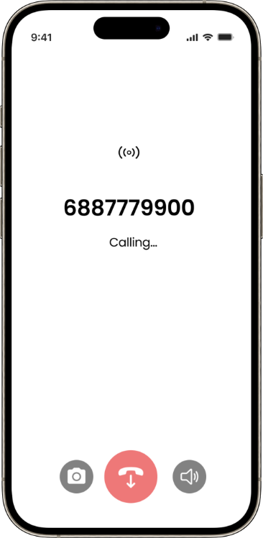
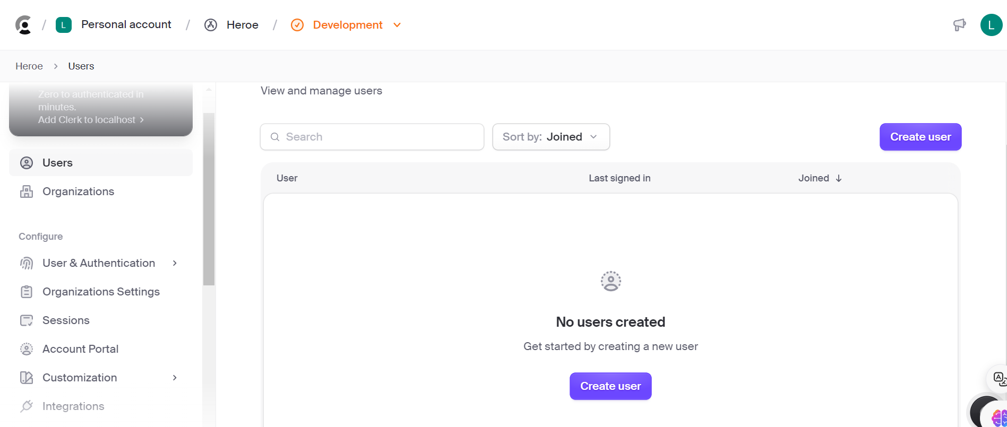
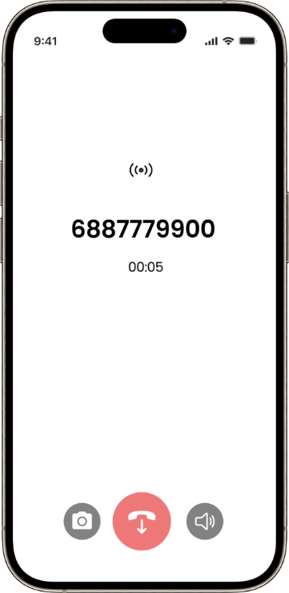
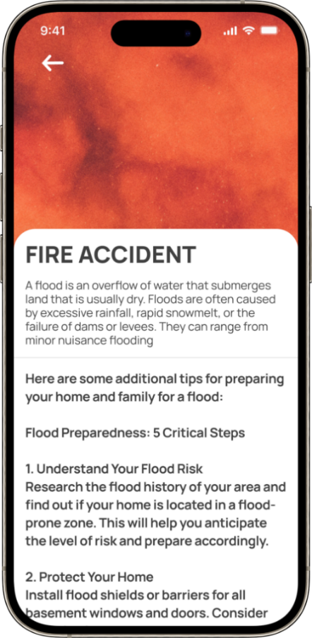

Slide 21


10
CONCLUSION
We have come to the end of the design and implementation of a disaster Management Mobile Application. Realising this project wasn’t easy, but with the help of God and consistent follow up from our supervisor, we were able to overcome some challenges. Some challenges faced were:
Consistent interruption of electrical supply
Unstable and low internet connection
Having access in downloading libraries and dealing with hocks and API
With continual research and persistent working, we tried to a certain extent to overcome these shortcomings.

Slide 22
15
THE END

